Slide 1
CNC Machine (Drawbot)
By Ali Ashraf and Ali Hamza Malik

Slide 2
Objectives:
To create a device capable of reading G-code corresponding to various commands for motors
To create a custom program to run our CNC machine
To allow for control using keyboard

Slide 3
A Cost Effective CNC Machine
CNC Machines are used in Industry, Workshops and by Hobbyists.
But these Machines are Expensive and usually difficult to operate.
Our solution is a cost effective CNC Machine made using cheap motor driver modules, Stepper motors and recycled Linear Actuators from an old printer

Slide 4
Implementation Details
User interface on command prompt
Initializes serial communication to communicate with arduino over USB
Two modes of operation
Read mode
Control mode

Slide 5
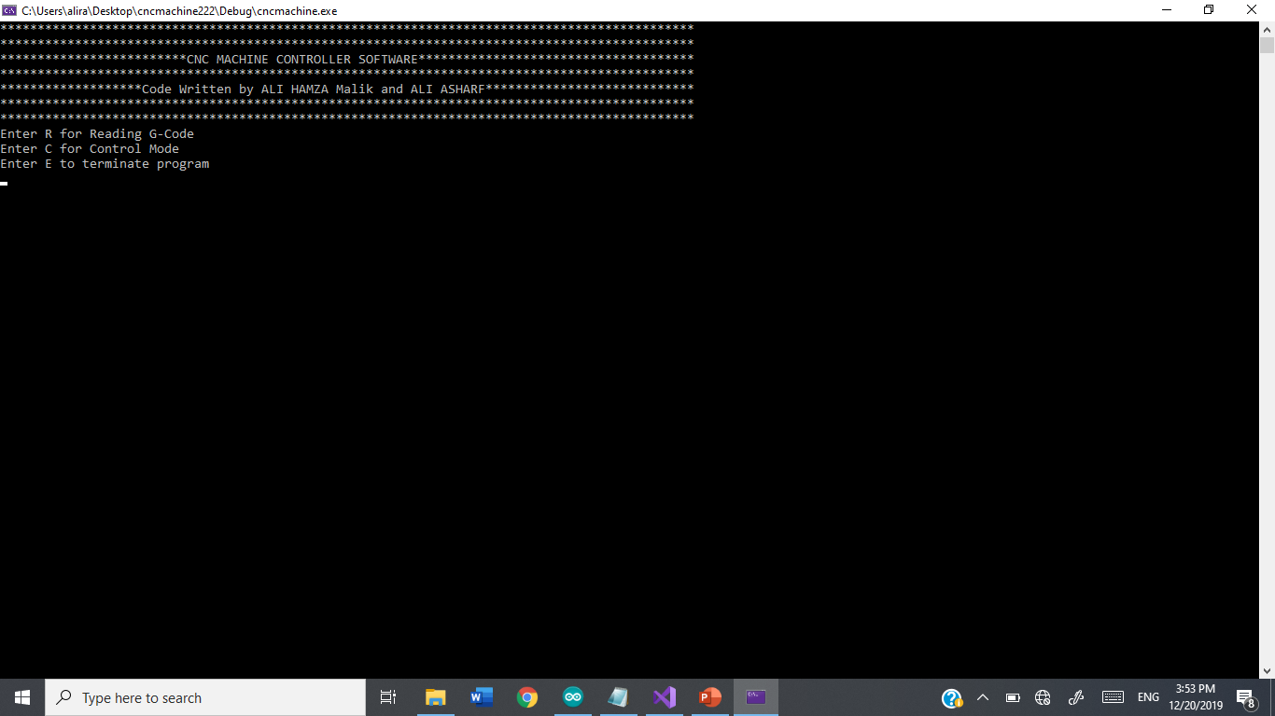

Slide 6
Work Distribution
There were three major parts of the program
Serial communication
G-code reader(File Handling)
Motor controller(Arduino)

Slide 7
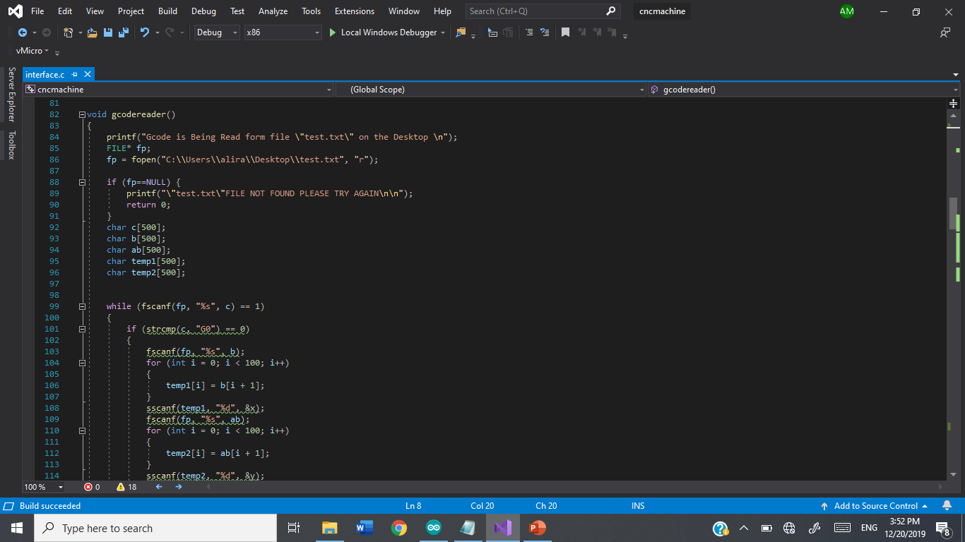

Slide 8
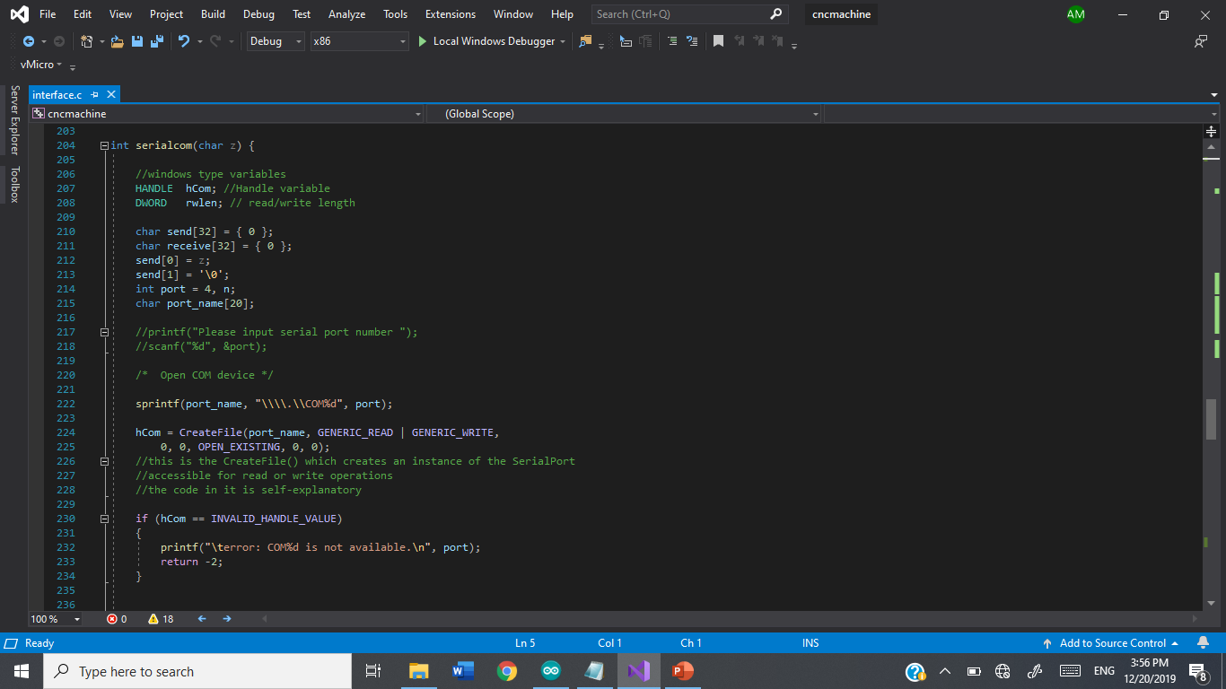

Slide 9
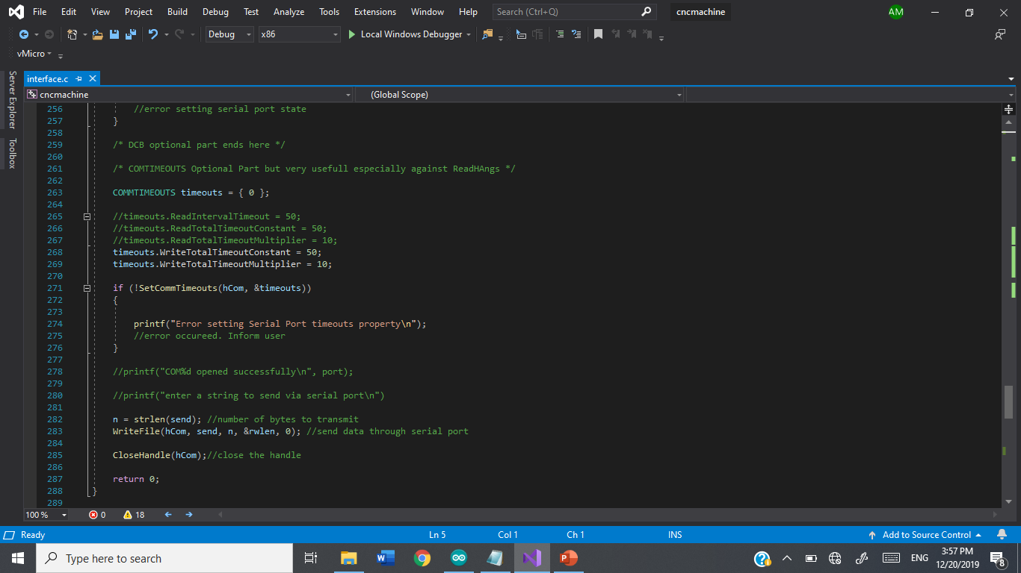

Slide 10
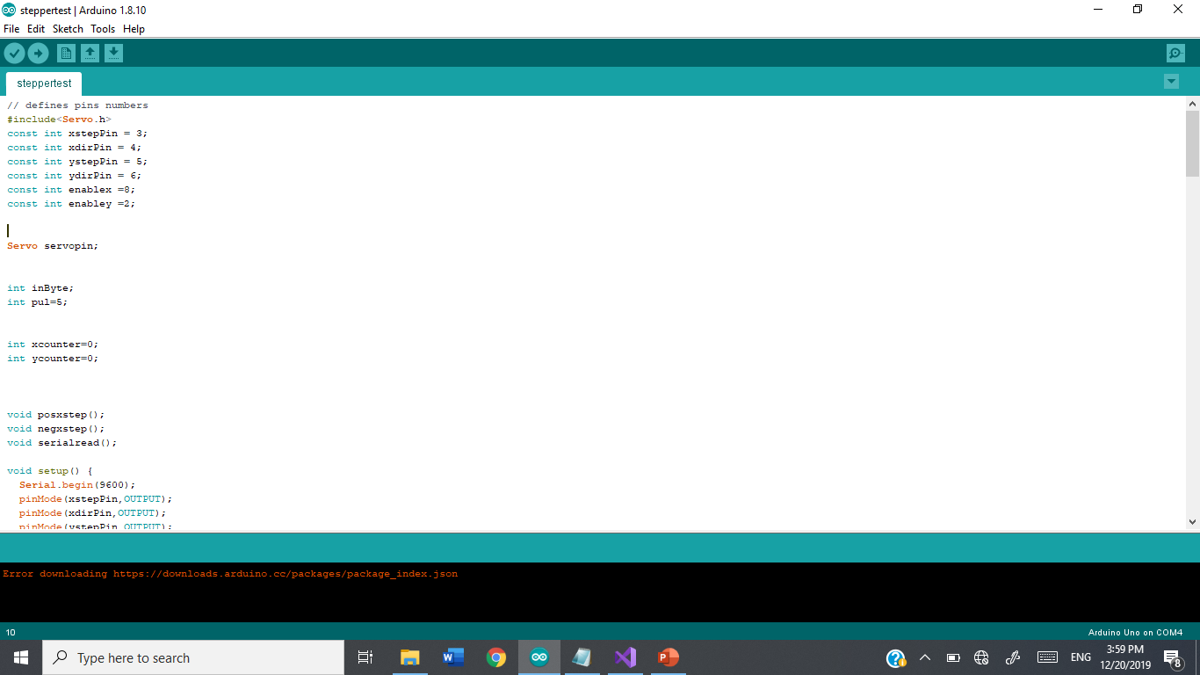

Slide 11
Problems Faced Solutions
Serial communication in C
Heating of motor drivers
Hardware Implementation
Time Management
Employing windows.h library
Taking advantage of enable pin on motor driver

Slide 12


Software Used
Arduino IDE and Visual Studios

Slide 13
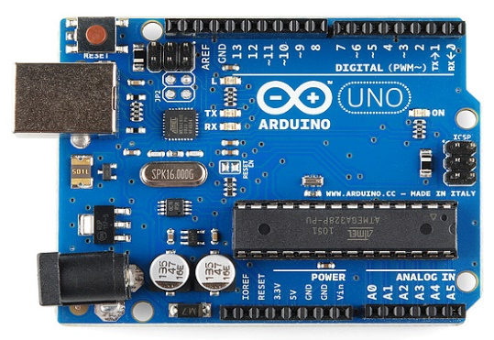
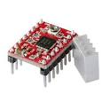
Modules Used
Arduino Uno R3
A4988 Stepper Motor Controller

Slide 14
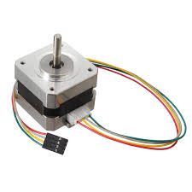
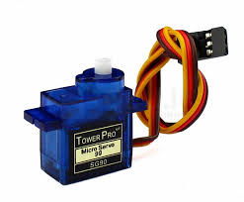
Modules Used
Stepper Motors
Servo Motor

Slide 15
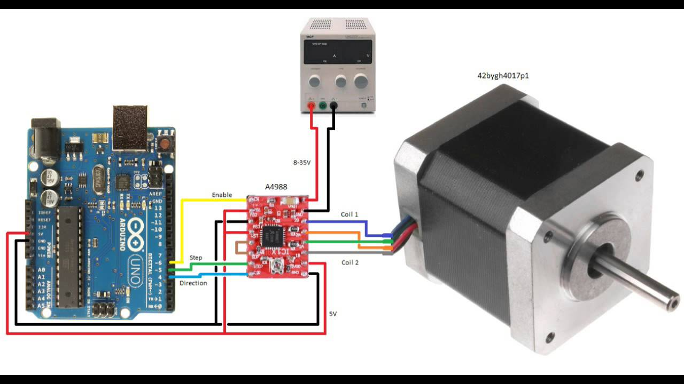
Schematic Diagram

Slide 16
Future Prospects
Milling Machines
3D Printer
Robots

Slide 17
Conclusion
CNC Machines are tools used by engineers for various tasks
An effective combination of hardware and software to perform certain repeated motions with higher precision
It was an interesting and challenging project to build

